Slide 1

Pharmacy Management System
By :-
S. PRANAV ADITH
CB.EN.U4CSE19458

Slide 2
FEATURES
View medicines and other pharmaceutical products not only by name but also images along with the price.
It also includes safe data store about medicine as well as fast information retrieval
Updating and deleting the stocks is done in an easier way

Slide 3
FEATURES
Checking the availability of medicines.
Order medicines that are out of stock or few in quantity

Slide 4
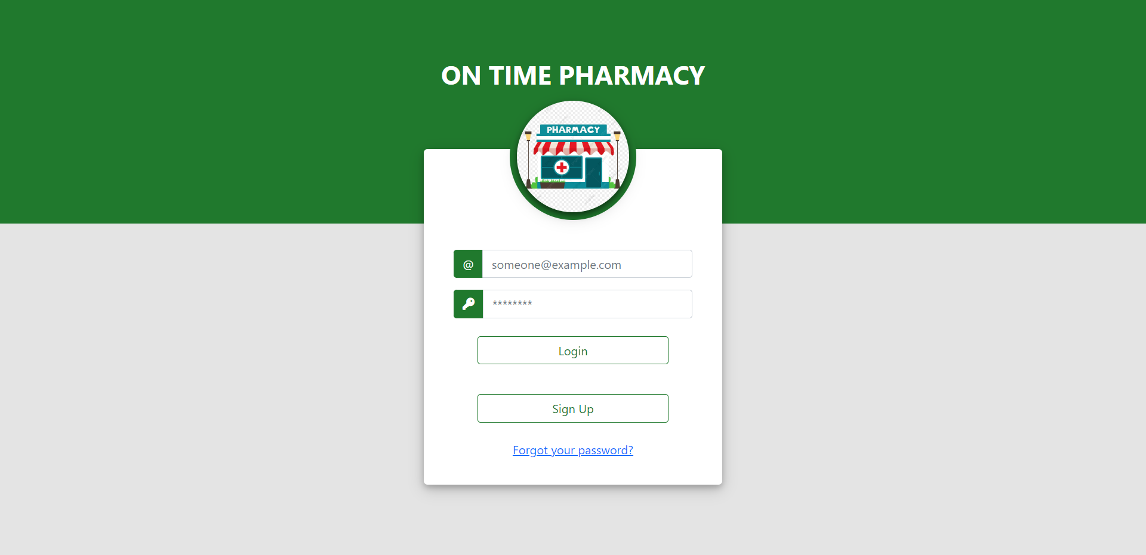
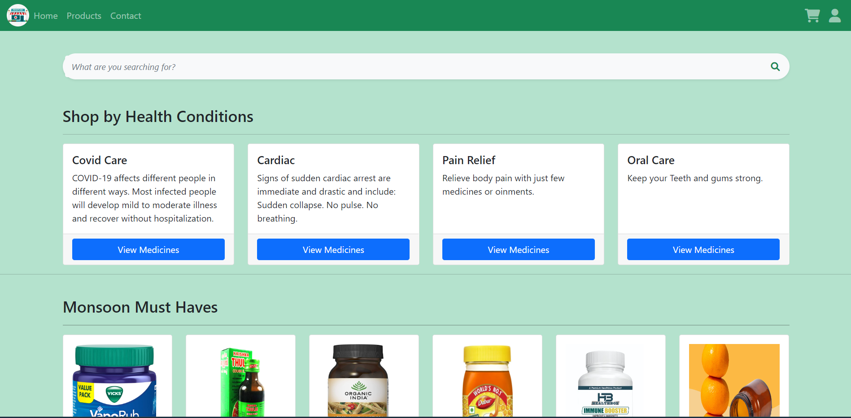
User Perspective
This Pharmacy Management System is a very simple and a user-friendly application
The navigation is made with ease of access
There is an option for the user to login to his/her account and order medicines.
They can add or delete or even increase the quantity of medicines they need to purchase in the cart section.

Slide 5
Thank You

